Slide 1

Powered by
Building an International Patient Summary Minimum Viable Product (MVP) with the YHCR open platform tools
A presentation by Lee Rickles

Slide 2

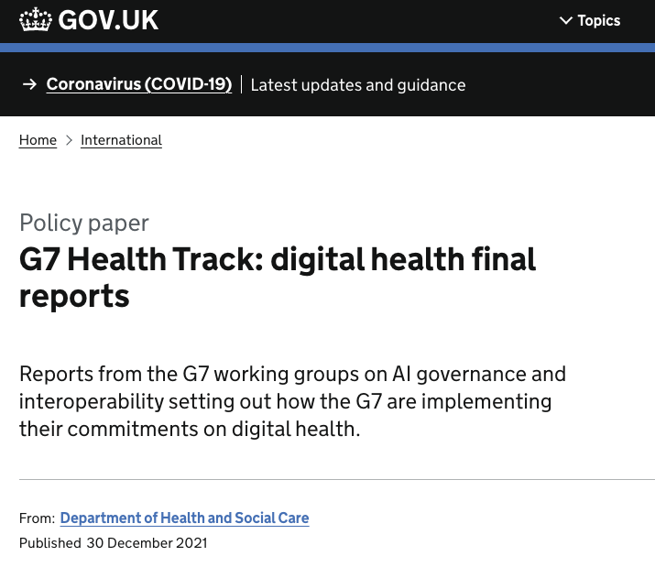

Digital health and care across the G7
Recognition of the importance of digital health solutions in transforming healthcare and of the need for appropriate data governance, system security, regulatory, and data protection standards in order to benefit from advances in digital health.
Commitment to working towards adopting a standardised minimum health dataset for patients’ health information, including through the International Patient Summary (IPS) standard; developing internationally shared principles for enabling patient access to health data; and promoting the use of open standards for health data.
Recognition of the need for multilateral collaboration on a standards-based, minimum data set for COVID-19 testing and vaccination verification and commitment to work within existing WHO processes to develop this and to work as G7 countries towards a process of mutual acceptance of COVID-19 certificates.
G7 Health Ministers’ Meeting, communique, Oxford, 4 June, 2021
https://www.gov.uk/government/publications/g7-health-track-digital-health-final-reports

Slide 3







IPS G7 PoC - a patient abroad
Patient’s memory – the current default situation
Patient held unstructured personal notes
Patient held structured notes (but not an IPS record)
Patient held hardcopy of the structured IPS record – e.g. PDF
Patient held computable, downloadable IPS record – e.g. USB stick
Patient mediated remotely stored IPS record
Direct system-to-system exchange

Slide 4
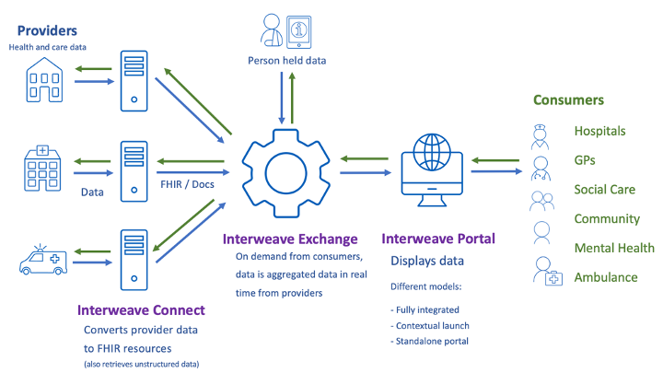
Interweave products

Slide 5
IPS Proof of Concept
Three elements
Confirming the requestor – authenticating the patient
Creating and curating the IPS - generate standard IPS record and pass to patient control
Consuming the IPS – patient choice to share, professional choice to consume

Slide 6


Step 1 - Confirming the requestor
NHS Login
National identity system assures patient identity
Patient initiates IPS request and provides personal content through their PHR
Personal Health Record e.g. HELM

Slide 7
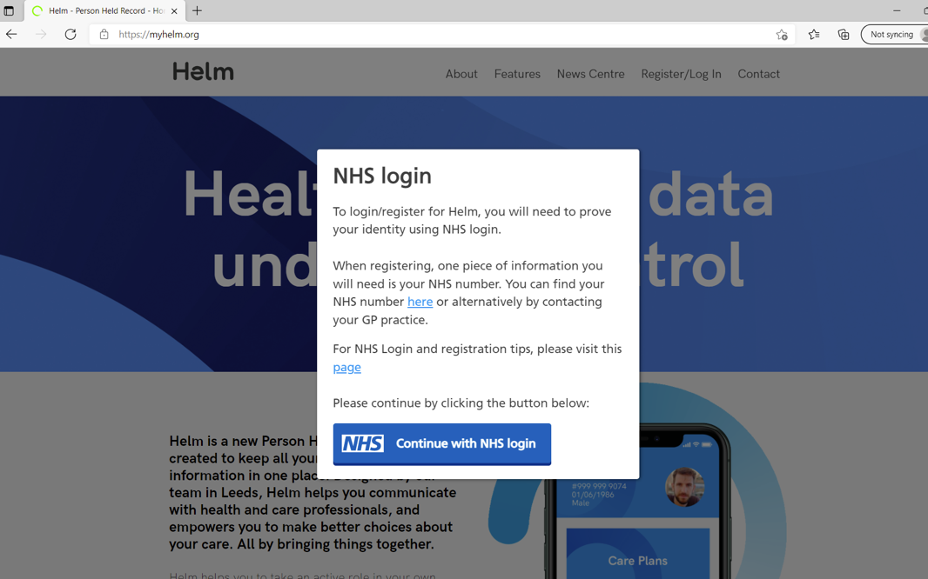
Patient logs into a portal to request their IPS

Slide 8
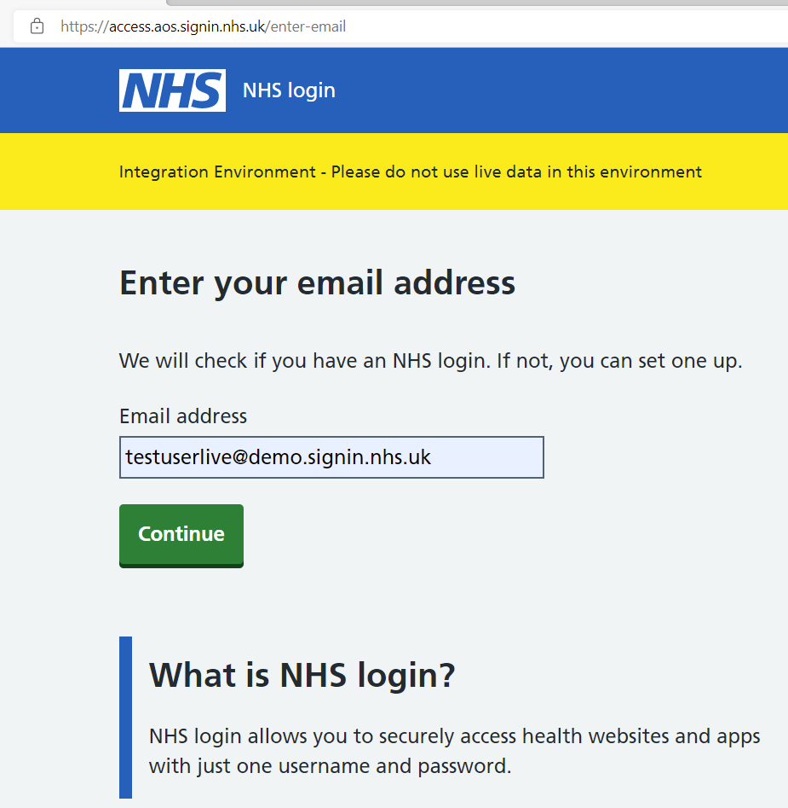
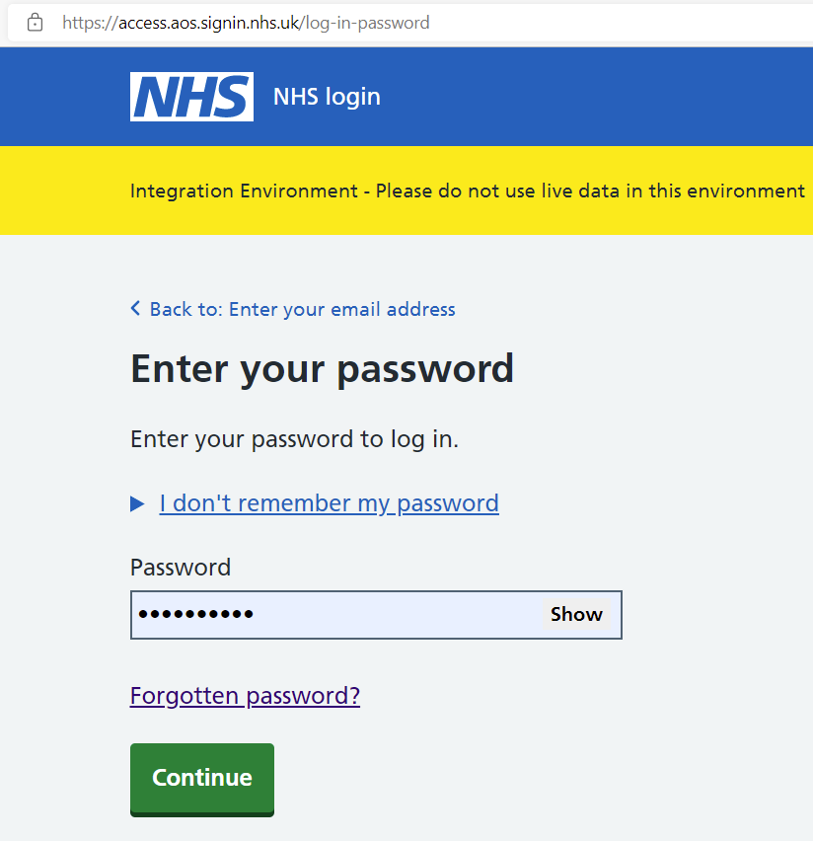
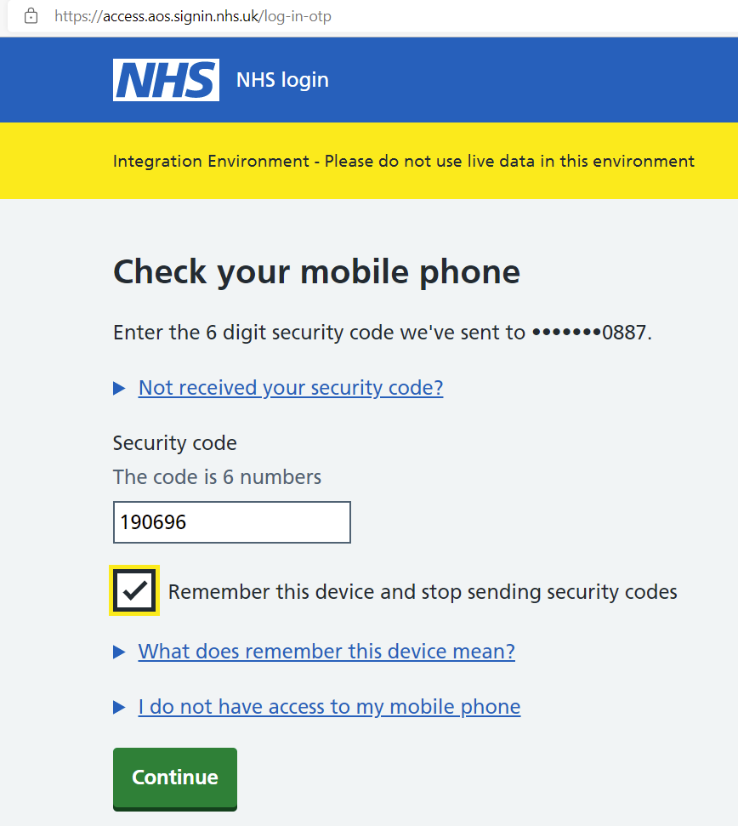
User authentication using NHS login

Slide 9
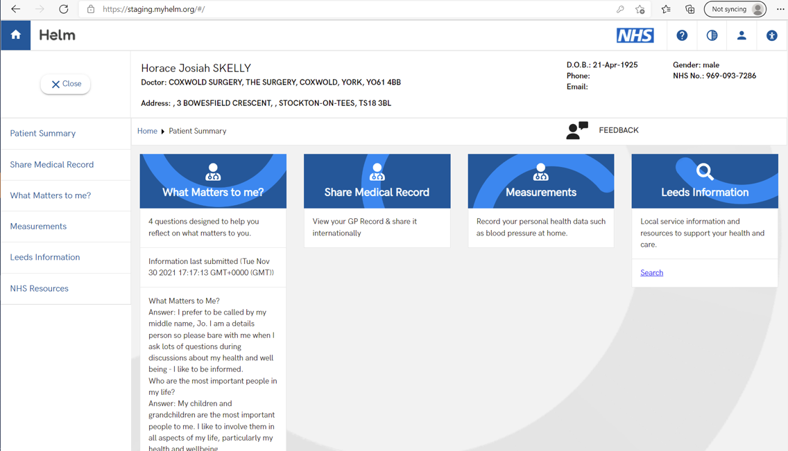
Patient requests IPS

Slide 10
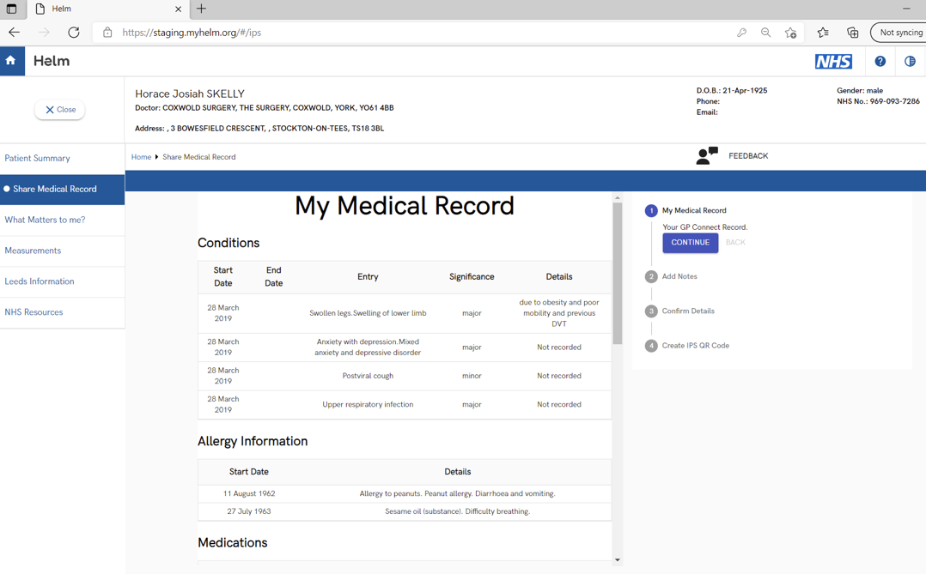
Patient views existing record

Slide 11
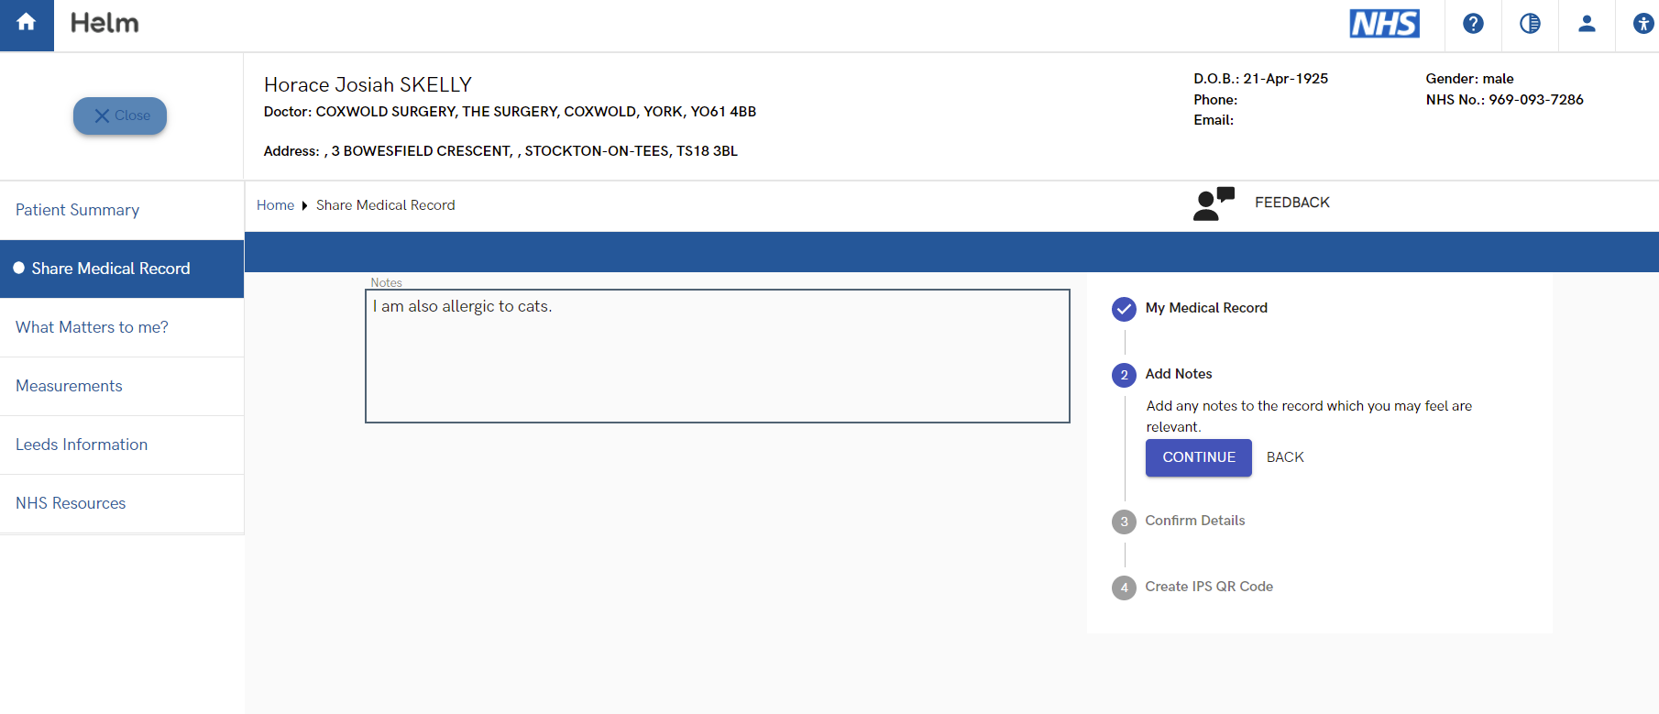
Patient adds notes to their record

Slide 12
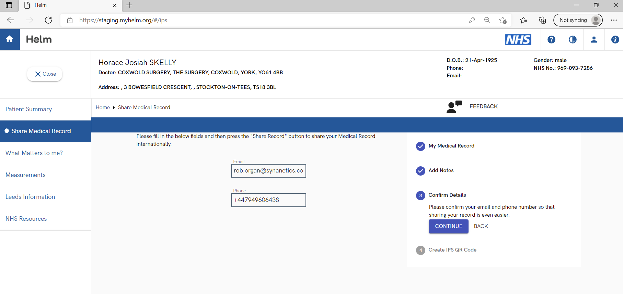
Patient confirms contact details

Slide 13
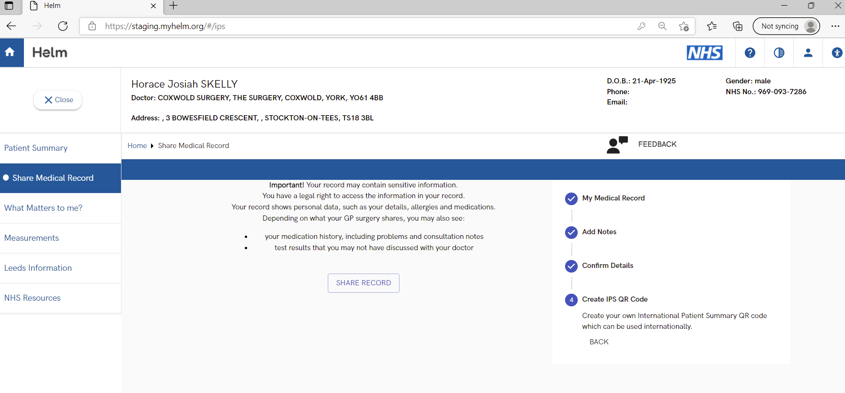
Patient authorises IPS generation

Slide 14


Step 2 - Creating and curating the IPS
NHS Login
GP record
National identity system assures patient identity
IPS sourced from GP record via GP-Connect
FHIR aggregation and process co-ordination
Patient initiates IPS request and provides personal content through their PHR
Data transacts through local shared care record
Personal Health record e.g. HELM
Open source QR Code generator
IPS record lodged within a FHIR store
POD

Slide 15
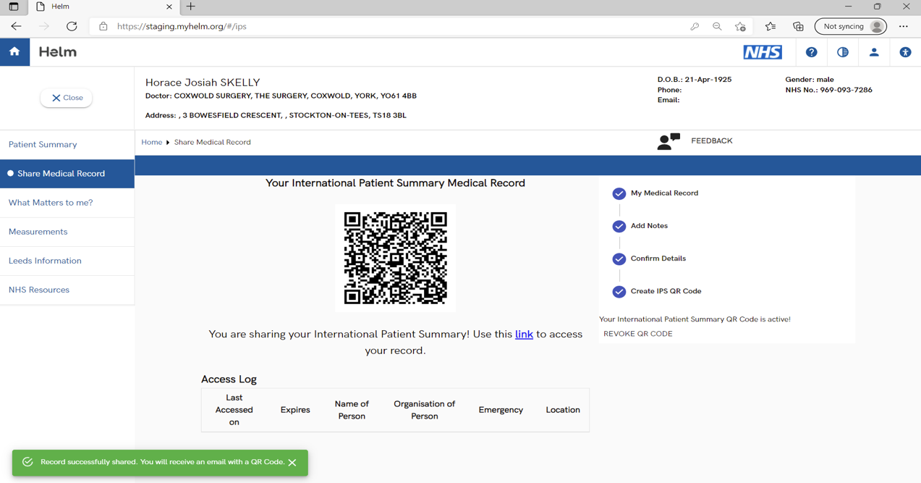
IPS successfully created

Slide 16
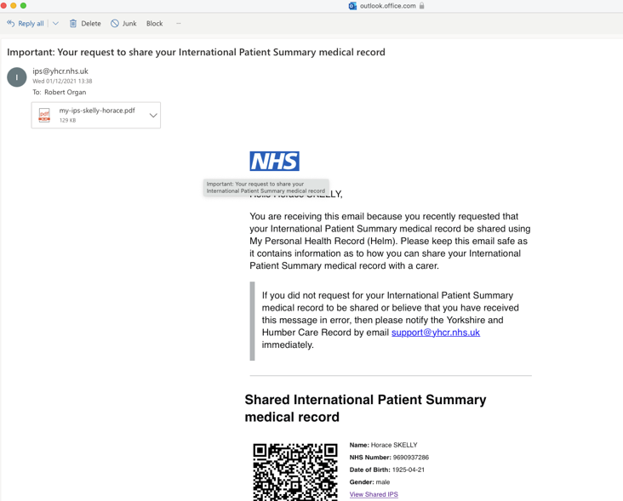
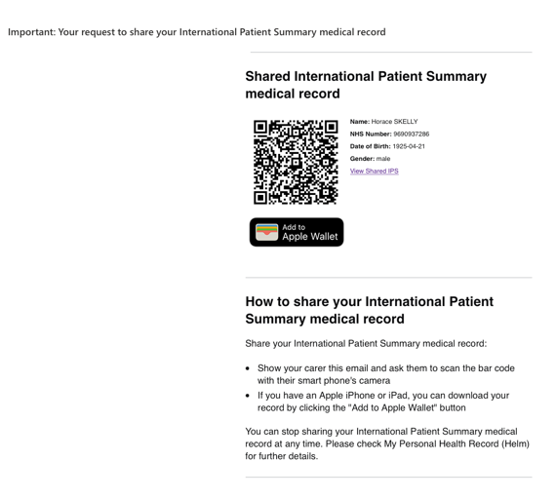
Patient receives an email with IPS

Slide 17
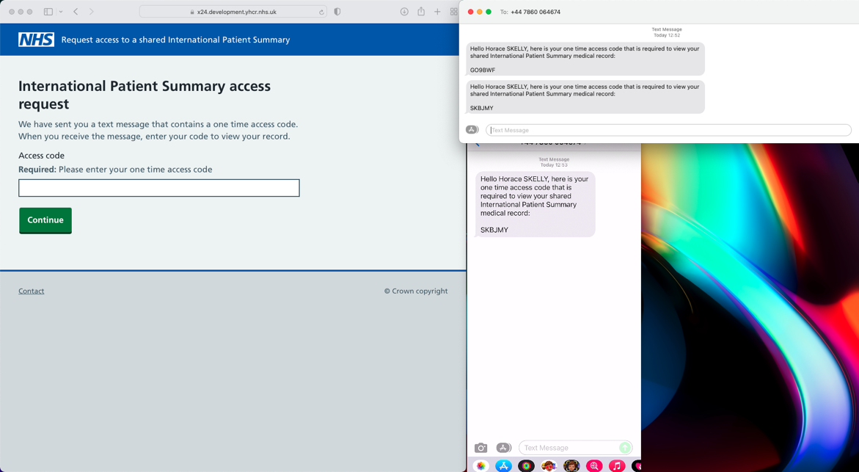
Patient receives SMS notification
Receives code via SMS

Slide 18
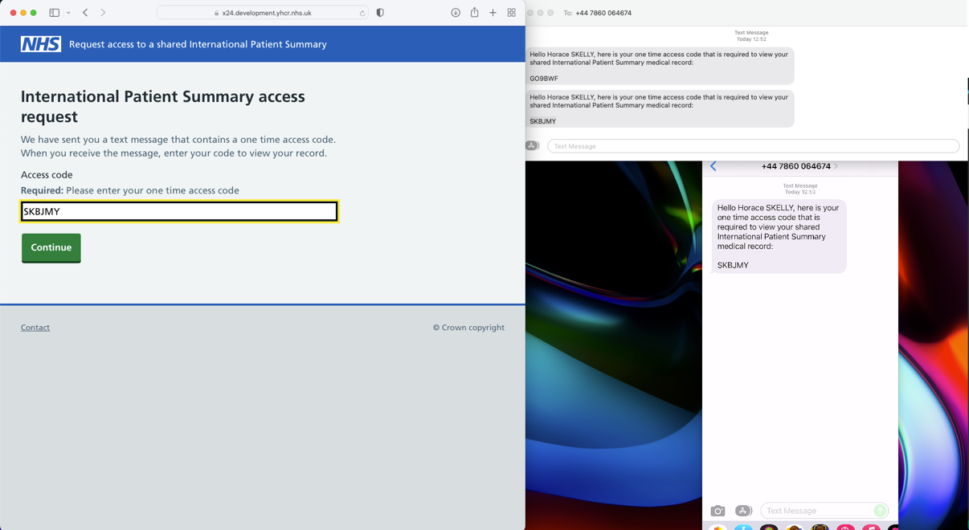
Patient enters access code
Enters access code and clicks continue

Slide 19
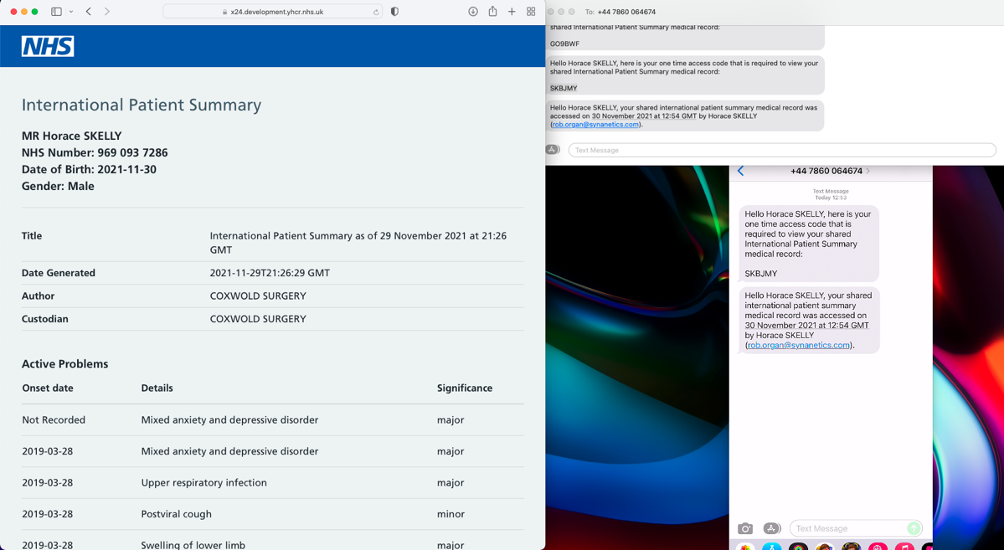
Patient views their IPS

Slide 20



Step 3 - Consuming the IPS
NHS Login
GP record
National identity system assures patient identity
IPS sourced from GP record via GP-Connect
FHIR aggregation and process co-ordination
Patient initiates IPS request and provides personal content through their PHR
Data transacts through local shared care record
Personal Health record e.g. HELM
Open source QR Code generator
IPS record lodged within a FHIR store
Patient provided QR code enables access to IPS
HTTPS server
HTML view
FHIR composition
POD
IPS accessed through browser of choice

Slide 21
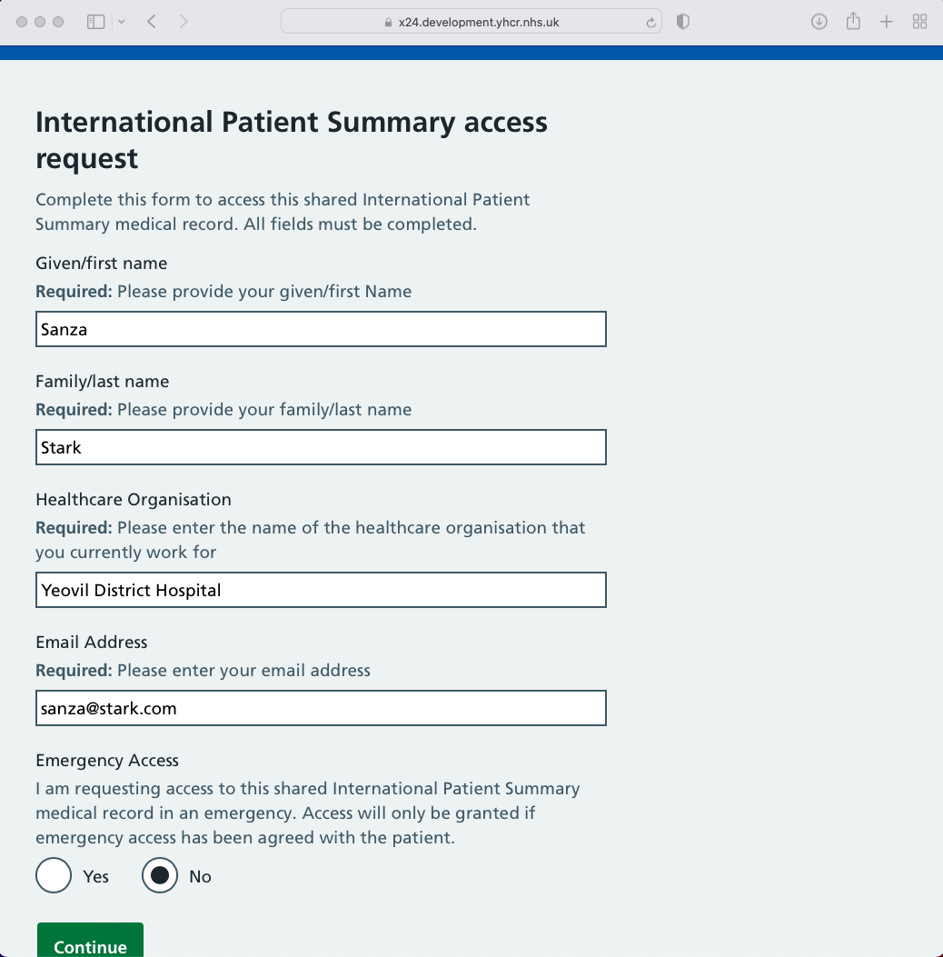
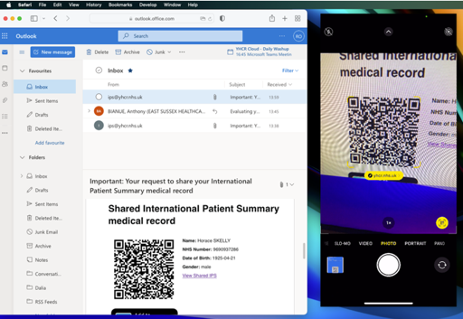
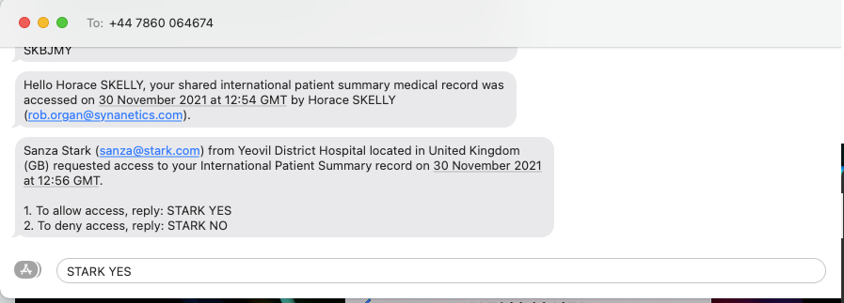
Carer scans the QR code and enters their details
1. Carer enters details
2. QR code scanned
3. Patient receives message requesting authorisation

Slide 22
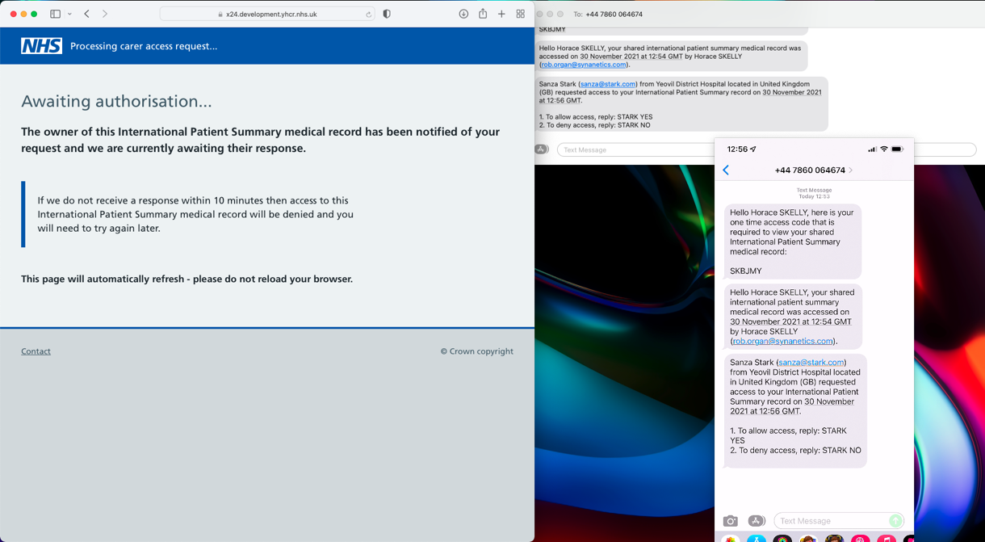
Carer waits for patient to authorise
4. Patient is sent message with access request details from carer.
Carer awaits authorisation.

Slide 23
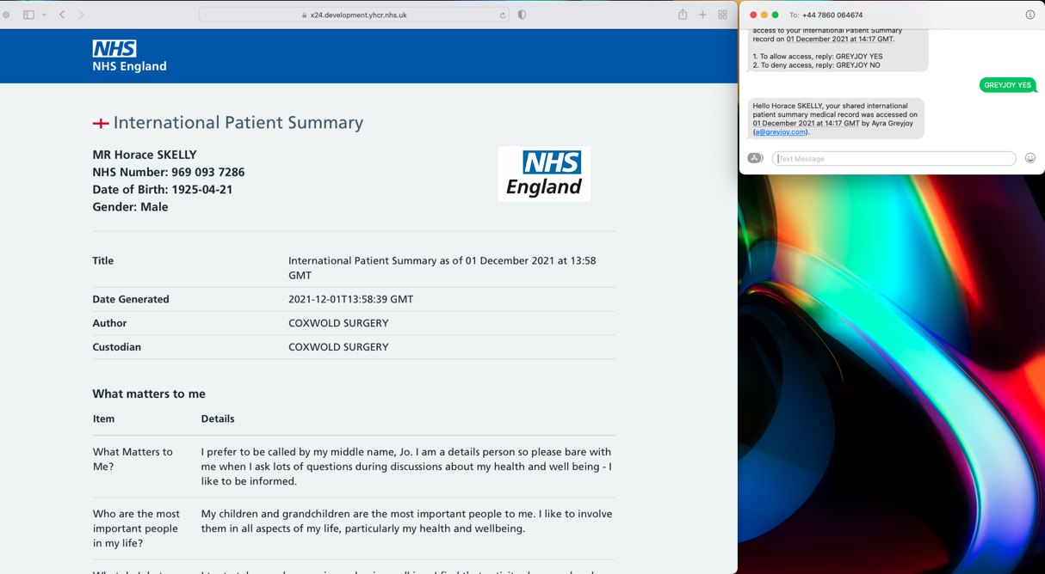
Carer views IPS

Slide 24
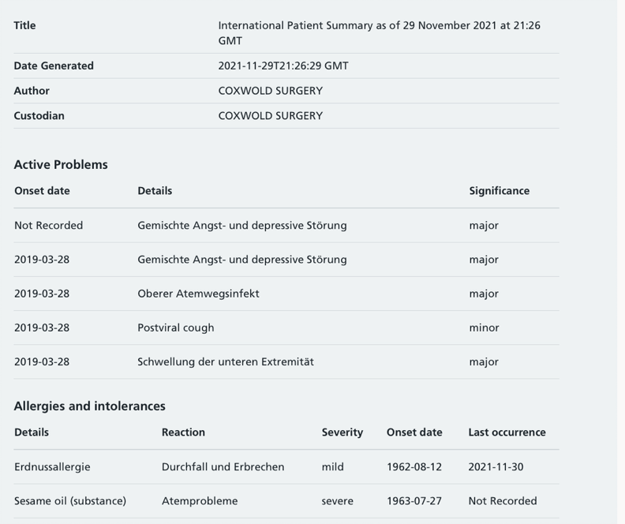
IPS translated to other languages

Slide 25
End

