Slide 1


INTRODUCTION
Paul Lewis
Server & Desktop Infrastructure Specialist @ UHMB

Slide 2
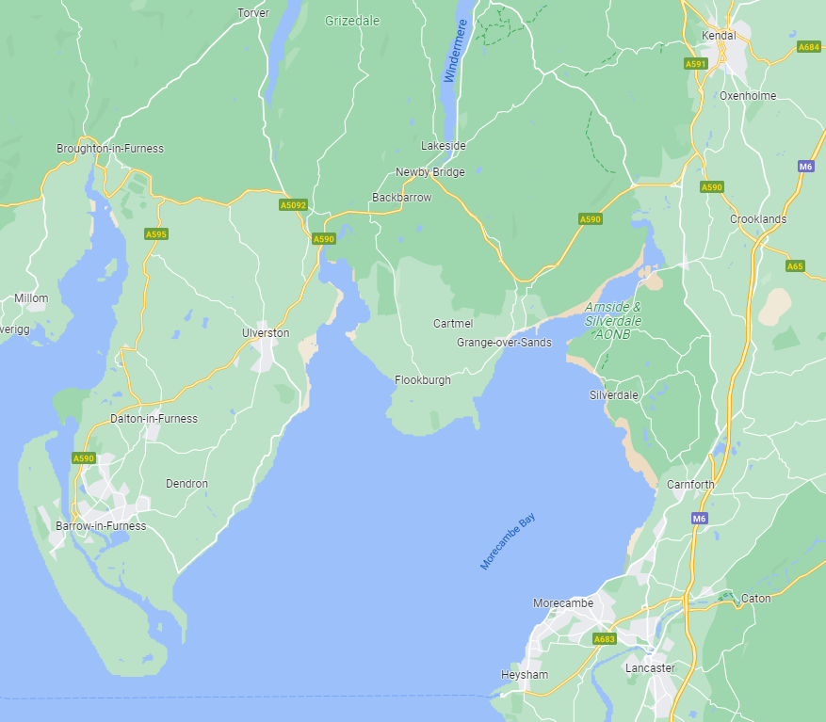
OUR HOSPITALS
3 main hospital sites – Furness General Hospital, Royal Lancaster Infirmary & Westmorland General Hospital
Circa 8,000 staff
Provide services for Community Staff, GP's and other healthcare premises within Cumbria and Lancashire

Slide 3

MDM SOLUTION
2,200 devices enrolled
Integrated with Apple Business Manager (DEP)
In-house developed iOS and Android applications deployed centrally
Integrated with On-Prem Active Directory for enrolment

Slide 4

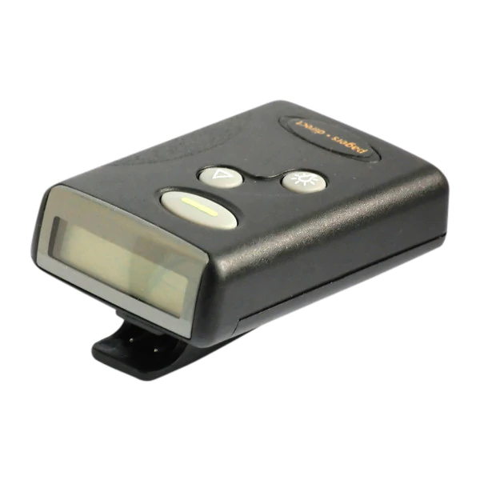
WHY GROUND CONTROL?
Outdated technology such as bleeps to go by the end of 2021
Replaced with 200 modern iPhone 11's with an in-house developed application
Devices are assigned to a clinician on a 'per shift basis' - Shared Devices rather than 1-to-1.
Full device erase every time an iPhone is returned.

Slide 5
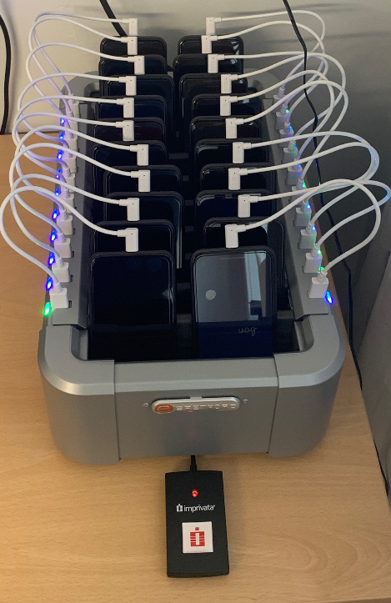
EQUIPMENT SET-UP
Charge & Sync Station with 20 mini lightening cables
20 x iPhone 11's
Windows 10 SFF PC (No keyboard, Mouse, Screen)
Proximity Reader

Slide 6

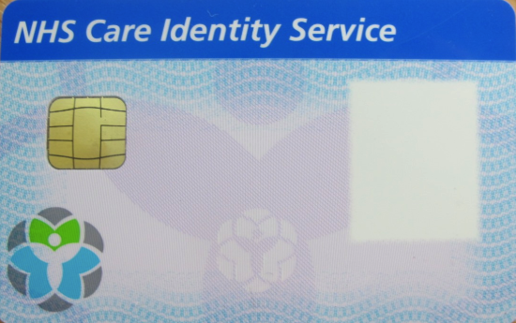
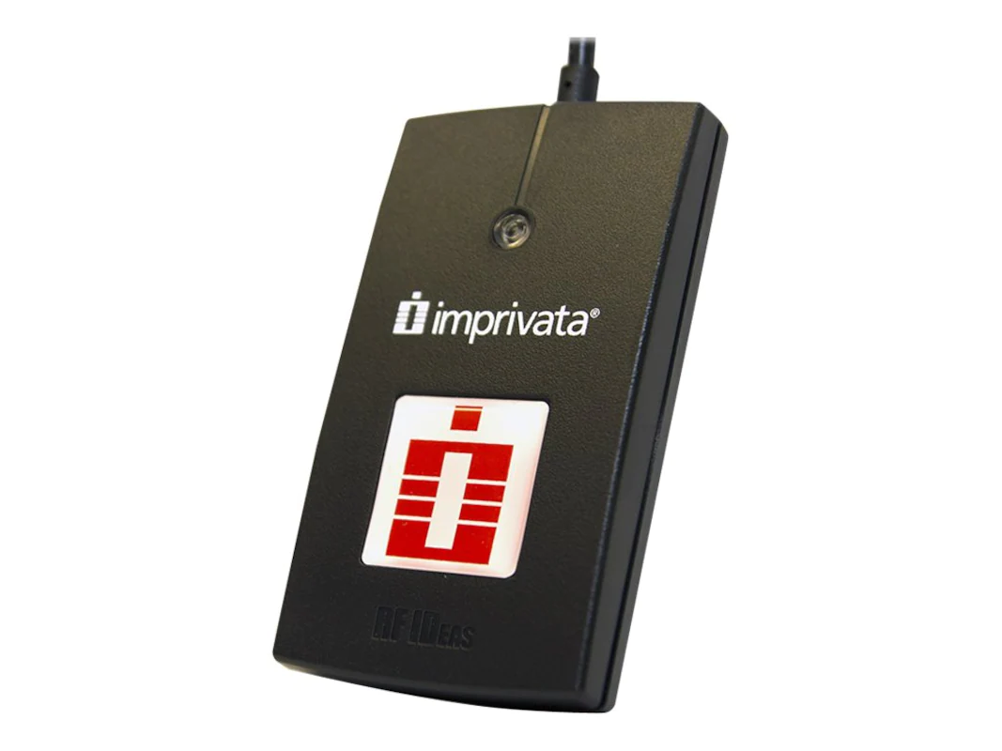


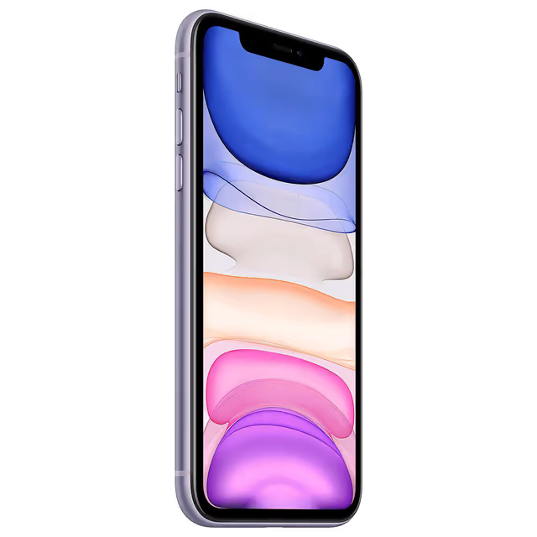

DEVICE CHECK-OUT PROCESS

Slide 7
WHAT ARE THE BENEFITS?
Asset Management - devices are assigned to an individual on check-out and can easily be identified from the MDM
Full audit trail for each device via the ground control admin portal
Easy to manage workflows
Ability to perform a full device wipe once a device is checked back in
Ability to keep devices updated through managed iOS updates

Slide 8

THANKYOU
QUESTIONS

